Slide 1
Image Analysis

Slide 2
Image Smoothing and Sharpening

Slide 3
Spatial smoothing and image approximation
Spatial smoothing may be viewed as a process for estimating the value of a pixel from its neighbours.
What is the value that “best” approximates the intensity of a given pixel given the intensities of its neighbours?
We have to define “best” by establishing a criterion.

Slide 4
Spatial Filtering: Smoothing (Low-pass)
Origin
x
104
100
108
¹/₉
¹/₉
¹/₉
99
106
98
*
¹/₉
¹/₉
¹/₉
95
90
85
¹/₉
¹/₉
¹/₉
Original Image Pixels
Filter
¹/₉
¹/₉
¹/₉
Simple 3*3 Neighbourhood
104
100
108
3*3 Smoothing Filter
¹/₉
¹/₉
¹/₉
99
106
98
¹/₉
¹/₉
¹/₉
95
90
85
e = ¹/₉*106 + ¹/₉*104 + ¹/₉*100 + ¹/₉*108 + ¹/₉*99 + ¹/₉*98 + ¹/₉*95 + ¹/₉*90 + ¹/₉*85
= 98.3333
y
Image f (x, y)
The above is repeated for every pixel in the original image to generate the smoothed image.

Slide 5
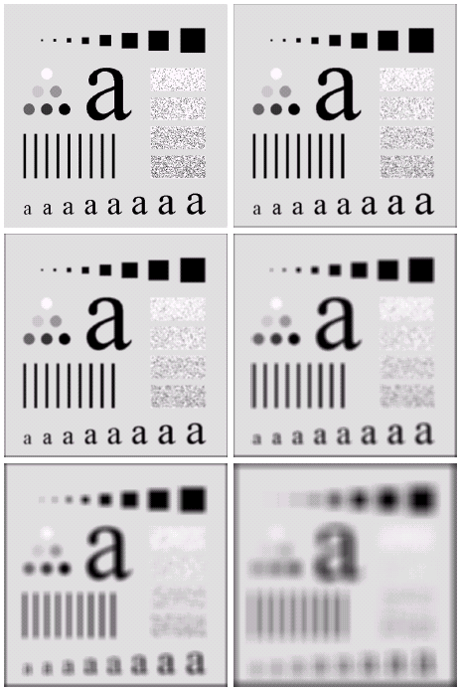
Image Smoothing Example
The image at the top left is an original image of size 500*500 pixels
The subsequent images show the image after filtering with an averaging filter of increasing sizes
3, 5, 9, 15 and 35
Notice how detail begins to disappear

Slide 6
Weighted Smoothing Filters
More effective smoothing filters can be generated by allowing different pixels in the neighbourhood different weights in the averaging function
Pixels closer to the central pixel are more important
Often referred to as a weighted averaging
¹/₁₆ | ²/₁₆ | ¹/₁₆
²/₁₆ | ⁴/₁₆ | ²/₁₆
¹/₁₆ | ²/₁₆ | ¹/₁₆
Weighted averaging filter

Slide 7
Sharpening Spatial Filters ( high pass)
Previously we have looked at smoothing filters which remove fine detail
Sharpening spatial filters seek to highlight fine detail
Remove blurring from images
Highlight edges
Useful for emphasizing transitions in image intensity
Sharpening filters are based on spatial differentiation

Slide 8
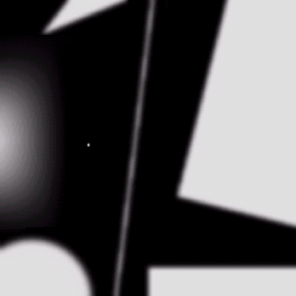
Spatial Differentiation
Differentiation measures the rate of change of a function
Let’s consider a simple 1 dimensional example

Slide 9
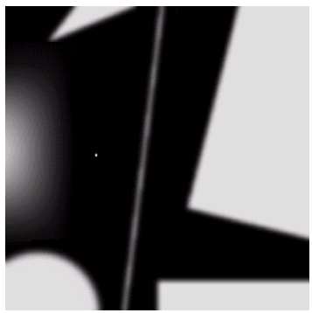
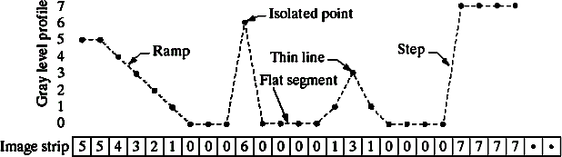
Spatial Differentiation
A B

Slide 10
Derivative Filtering
1st derivative filter output
Zero at constant intensities
Non zero at the onset of a step or ramp
Non zero along ramps
2nd derivative filter output
Zero at constant intensities
Non zero at the onset and end of a step or ramp
Zero along ramps of constant slope

Slide 11
1st Derivative
The formula for the 1st derivative of a function is as follows:
It’s just the difference between subsequent values and measures the rate of change of the function

Slide 12
Spatial Differentiation
A B

Slide 13
1st Derivative (cont…)
5 | 5 | 4 | 3 | 2 | 1 | 0 | 0 | 0 | 6 | 0 | 0 | 0 | 0 | 1 | 3 | 1 | 0 | 0 | 0 | 0 | 7 | 7 | 7 | 7
 | 0 | -1 | -1 | -1 | -1 | -1 | 0 | 0 | 6 | -6 | 0 | 0 | 0 | 1 | 2 | -2 | -1 | 0 | 0 | 0 | 7 | 0 | 0 | 0

Slide 14
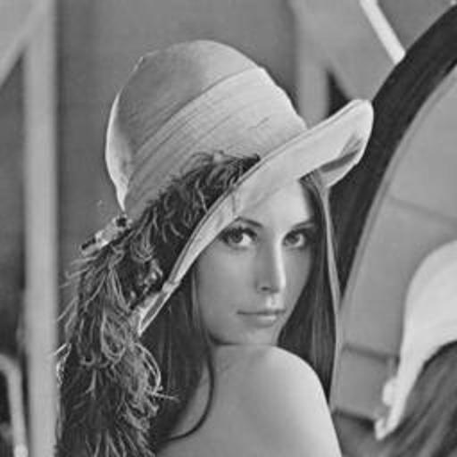
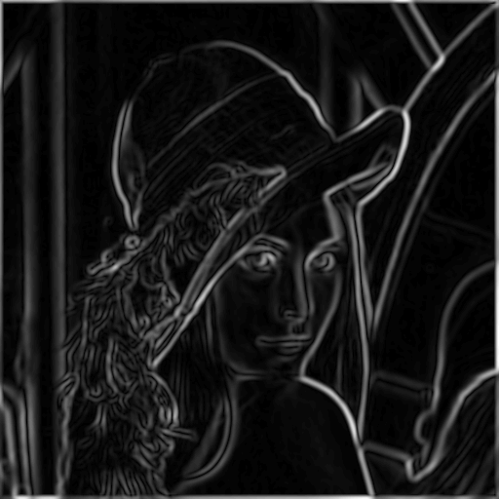
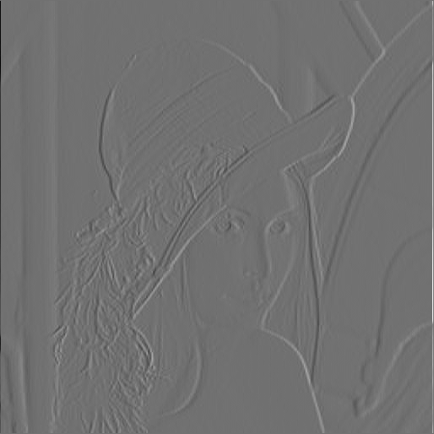
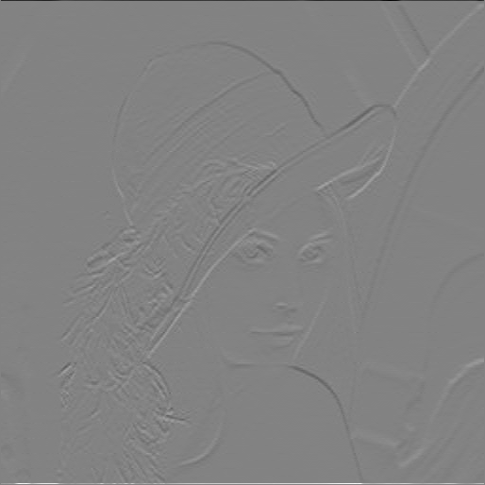
1st Derivative (cont.)

Slide 15
2nd Derivative
The formula for the 2nd derivative of a function is as follows:
Simply takes into account the values both before and after the current value

Slide 16
Spatial Differentiation
A B

Slide 17
2nd Derivative (cont…)
5 | 5 | 4 | 3 | 2 | 1 | 0 | 0 | 0 | 6 | 0 | 0 | 0 | 0 | 1 | 3 | 1 | 0 | 0 | 0 | 0 | 7 | 7 | 7 | 7
 | -1 | 0 | 0 | 0 | 0 | 1 | 0 | 6 | -12 | 6 | 0 | 0 | 1 | 1 | -4 | 1 | 1 | 0 | 0 | 7 | -7 | 0 | 0

Slide 18
Using Second Derivatives For Image Enhancement
Edges in images are often ramp-like transitions
1st derivative is constant and produces thick edges
2nd derivative zero crosses the edge (double response at the onset and end with opposite signs)
A common sharpening filter is the Laplacian
Isotropic
One of the simplest sharpening filters
We will look at a digital implementation

Slide 19
The Laplacian
The Laplacian is defined as follows:
where the partial 1st order derivative in the x direction is defined as follows:
and in the y direction as follows:

Slide 20
The Laplacian (cont…)
So, the Laplacian can be given as follows:
We can easily build a filter based on this
0
1
0
1
-4
1
0
1
0

Slide 21
Spatial filters : Sharpening
₁st _{VS 2}nd
derivative sharpening
1st derivative sharpening produces thicker edges in an image. 1st derivative sharpening has stronger response to gray level change
2nd derivative sharpening has stronger response to fine details, such as thin lines and isolated points.
2nd derivative sharpening has double response to gray level

Slide 22
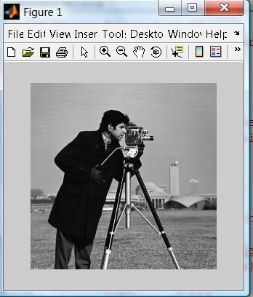
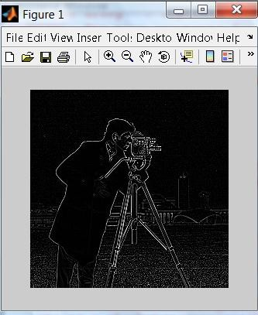
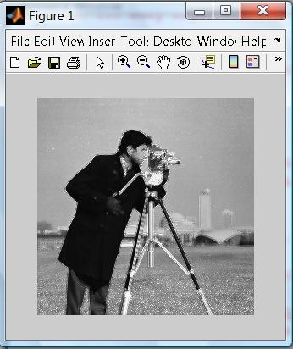
Laplace Sharpened image
Laplace filtered image

Slide 23
Laplacian Image Enhancement
Imfilter : for applying filter.
Fspecial : for choosing the filter:
Example: In MATLAB :
>> v=imread('picture2.jpg');
>> h=fspecial('laplacian‘,0);
>> Xp=imfilter(v,h);
>> imshow(Xp)
>> imshow(Xp+v)
Note: Xp=imfilter(x,p, ‘replicate‘)
This command will apply border padding instead of
zero padding

Slide 24
1st Derivative Filtering
Implementing 1st derivative filters is difficult in practice
For a function f(x, y) the gradient of f at coordinates (x, y) is given as the column vector:

Slide 25
1st Derivative Filtering (cont…)
The magnitude of this vector is given by:
For practical reasons this can be simplified as:

Slide 26
1st Derivative Filtering (cont…)
There is some debate as to how best to calculate these gradients but we will use:
which is based on these coordinates
z₁
z₂
z₃
z₄
z₅
z₆
z₇
z₈
z₉

Slide 27
Sobel Operators
Based on the previous equations we can derive the Sobel Operators
To filter an image it is filtered using both operators the results of which are added together
-1
-2
-1
-1
0
1
0
0
0
-2
0
2
1
2
1
-1
0
1

Slide 28
MATLAB
Imfilter : for applying filter.
Fspecial : for choosing the filter:
Example: In MATLAB :
>>v=fspecial(‘sobel’)
>>Y=v’
→ horizontal sobel
→ vertical sobel
>>m= imread(‘cameraman.tif‘);
>>Fp=imfilter(m,v) → this command will apply sobel filter on image
>>Imshow(Fp) → this command will show the sobel sharpened image
>>imshow(m+Fp) → this command will show the filtered image after
applying sobel

Slide 29
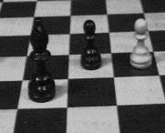
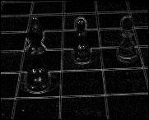
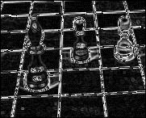
Sharpening Filters:
Laplacian
Sobel

Slide 30
Spatial Filtering (High-boost)/weighted
High-boost or high-frequency-emphasis filter
High pass = Original – Low pass
High boost = (K)(Original) – Low pass
= (K-1)(Original) + Original – Low pass
= (K-1)(Original) + High pass
When K=1, High boost = High pass
When K>1, Part of the original is added back to the highpass result.

Slide 31
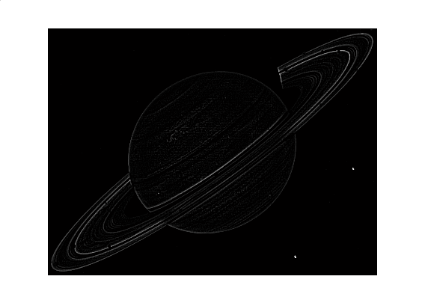
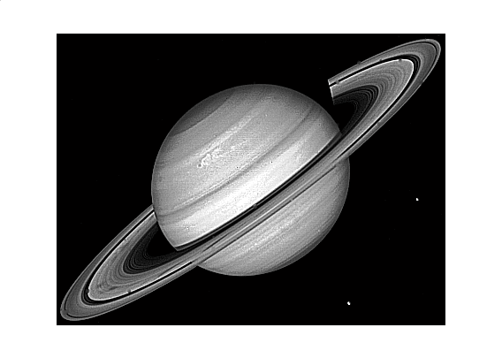
Spatial Filtering
A high-pass filter
A high-boost filter

Slide 32
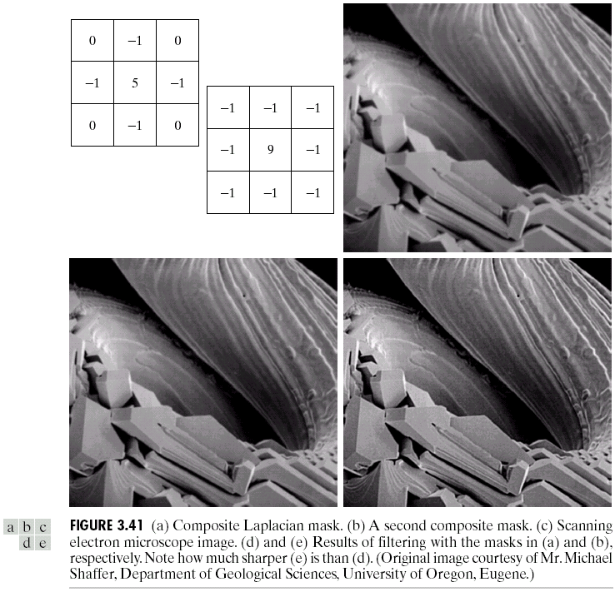
Simplified Image Enhancement (cont…)
This gives us a new filter which does the whole job for us in one step
0
-1
0
-1
5
-1
0
-1
0

Slide 33
Simplified Image Enhancement (cont…)

Slide 34
Variants On The Simple Laplacian
There are lots of slightly different versions of the Laplacian that can be used:
0
1
0
1
1
1
Simple Laplacian
Variant of Laplacian
1
-4
1
1
-8
1
0
1
0
1
1
1
-1
-1
-1
-1
9
-1
-1
-1
-1

Slide 35
Linear Spatial Filter
The MATLAB Toolbox supports a number of predefined 2-D linear filters. The fspecial generates a filter mask w
w = fspecial(‘type’, parameters)
Where type specifies the filter type, and parameters further define the specified filter.
Possible values for TYPE are:
'average' averaging filter
'disk' circular averaging filter
'gaussian' Gaussian lowpass filter
'laplacian' filter approximating the 2-D Laplacian operator
'log' Laplacian of Gaussian filter
'motion' motion filter
'prewitt' Prewitt horizontal edge-emphasizing filter
'sobel' Sobel horizontal edge-emphasizing filter
'unsharp' unsharp contrast enhancement filter

Slide 36
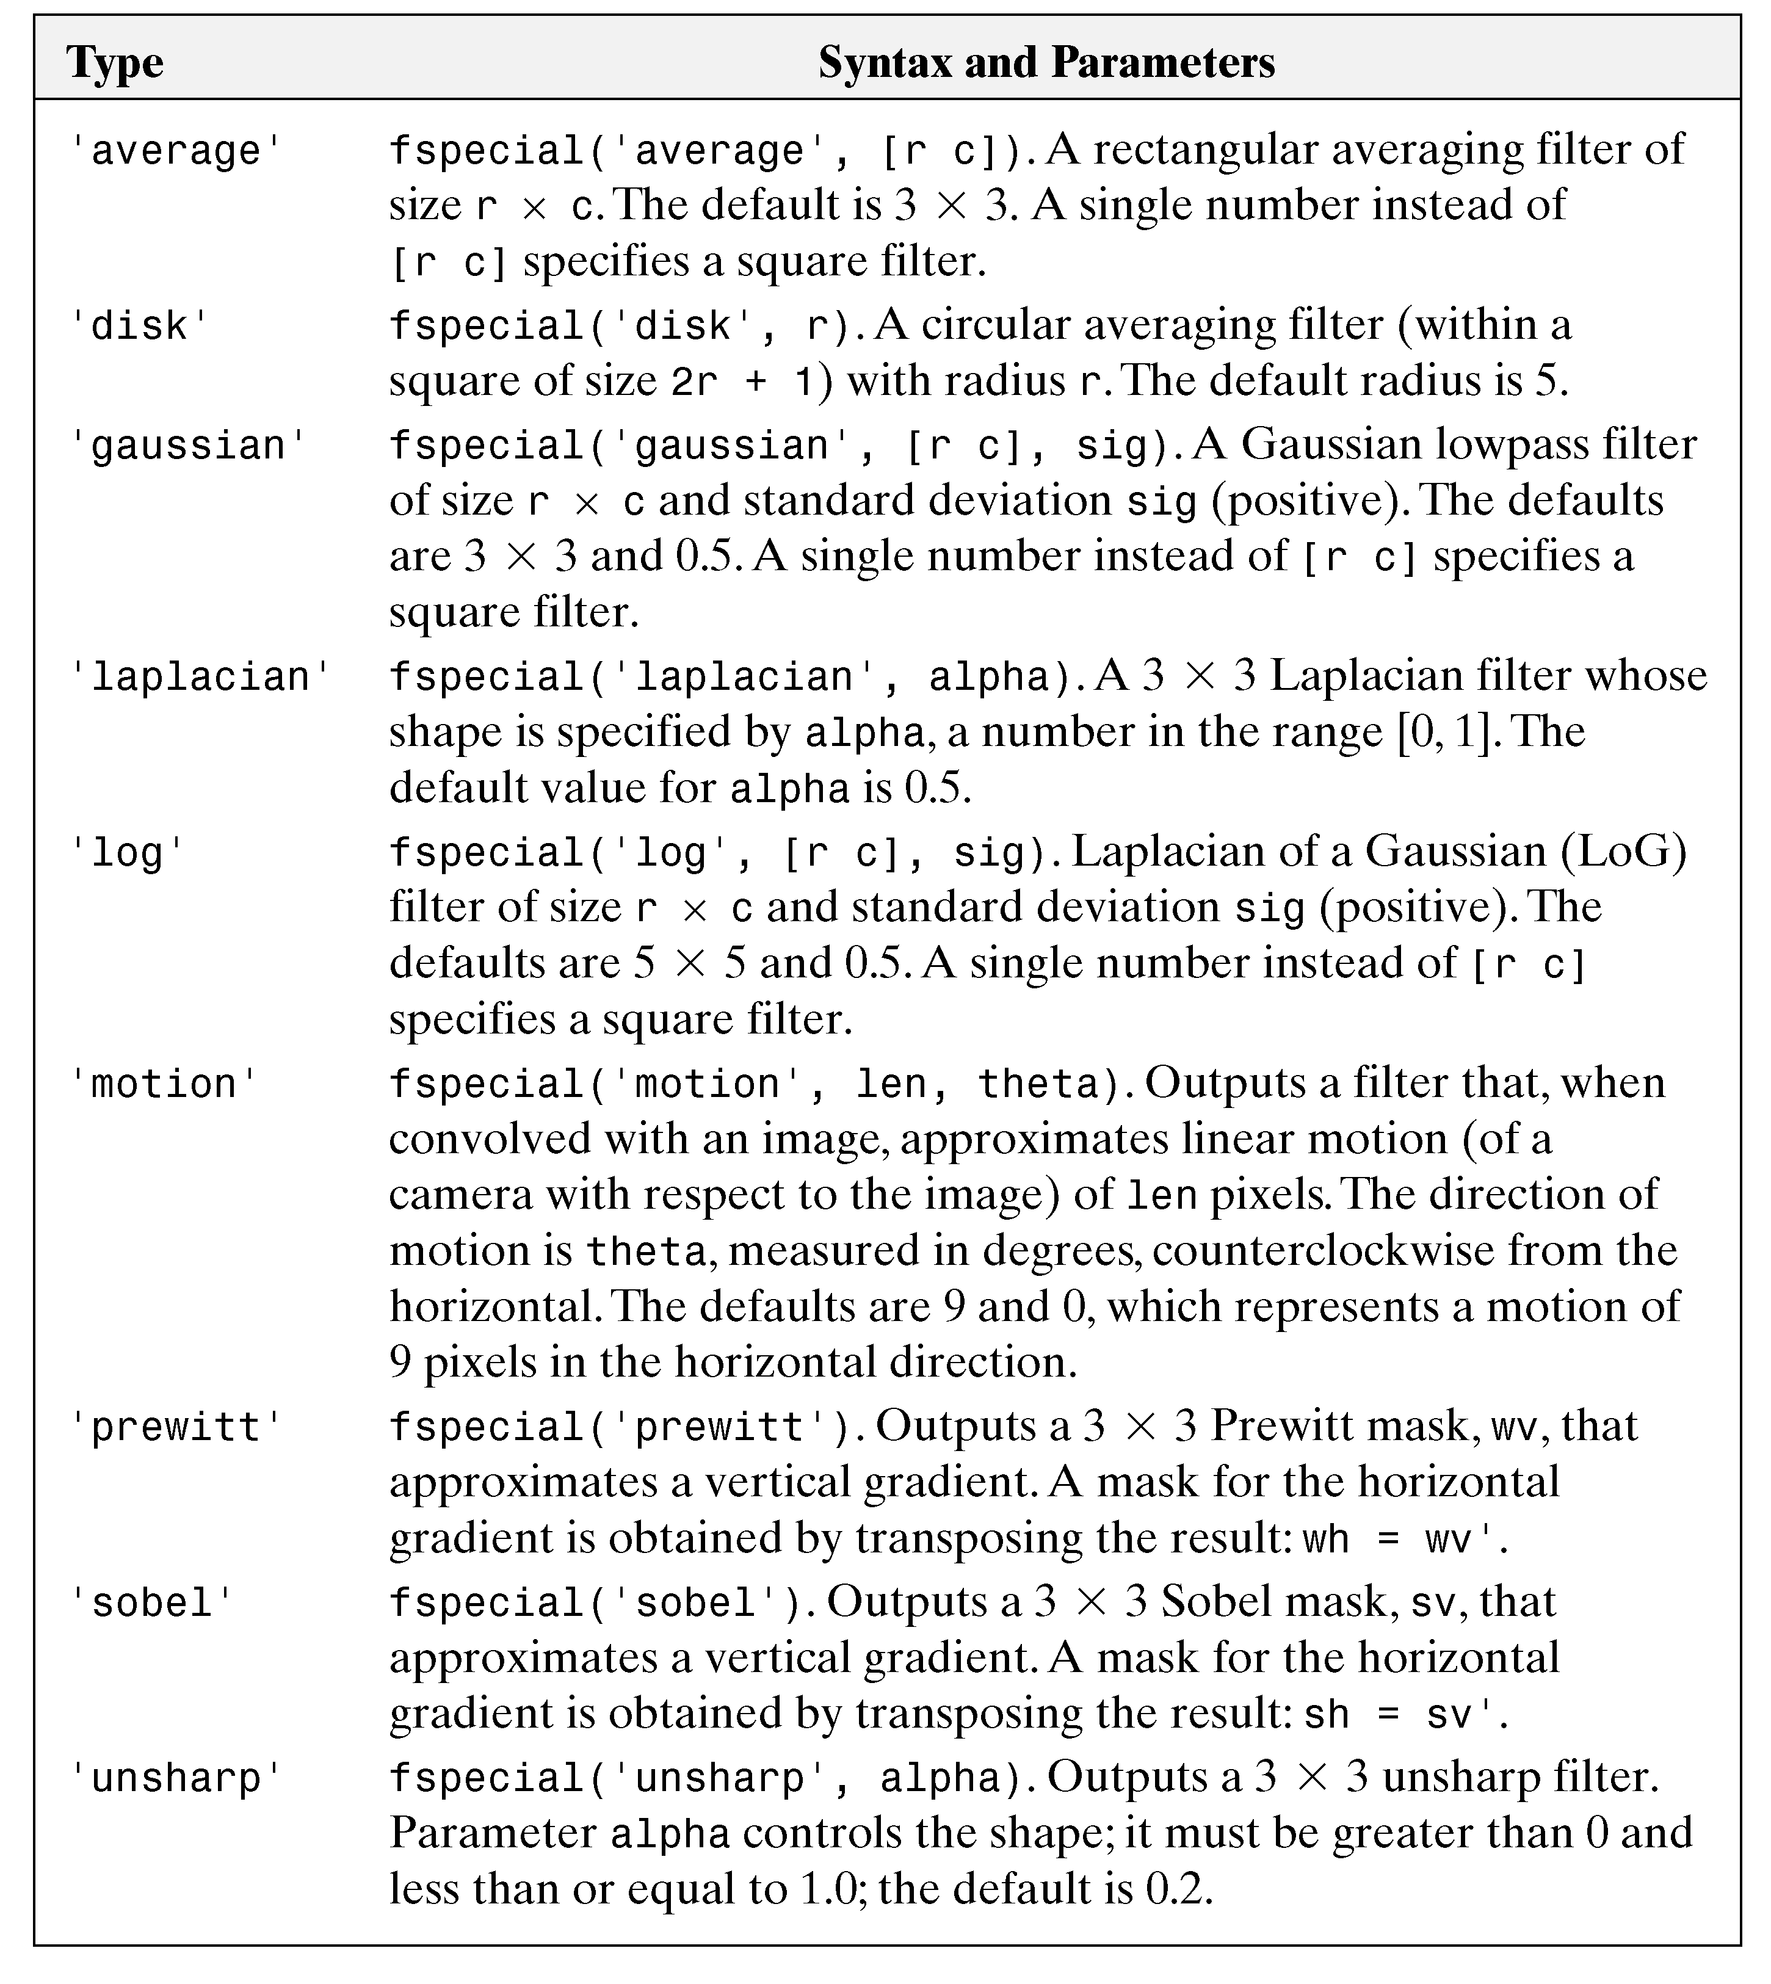

Slide 37
Nonlinear Spatial Filters
In MATLAB, the function ordfilt2 is used to generate order-statistic filters (also called rank filters). These contain nonlinear spatial filters whose response is based on ordering (ranking) the pixels contained in an image neighborhood and then replacing the value of the center pixel in the neighborhood with the value determined by the ranking result.
The syntax for this type of filter is:
g = ordfilt2(f, order, domain)

Slide 38
Spatial Filtering: Median Filter
Median filters are nonlinear.
A nonlinear (or non-linear) filter is a filter whose output is not a linear function of its input.
Median filtering reduces noise without blurring edges and other sharp details.
Median filtering is particularly effective when the noise pattern consists of strong, spike like components. (Salt-and-pepper noise.)

Slide 39
Spatial Filtering
Median Filter
Sort: (10 10 10 20 25 75 85 90 100)
Example
Original signal:
100 100 100 100 10 10 10 10 10
Noisy signal:
100 103 100 100 10 9 10 11 10
Filter by [ 1 1 1]/3:
101 101 70 40 10 10 10
Filter by 1x3 median filter:
100 100 100 10 10 10 10

Slide 40
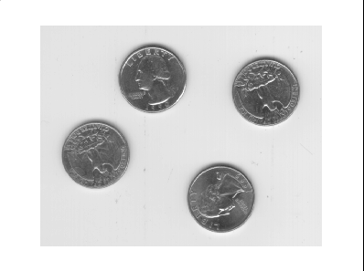



Averaging Filter Vs. Median Filter Example
Original
Salt&Pepper noise added
3x3 averaging filter
3x3 median filter

